Slide 1

课时练习
模块八 第二章 第二节

Slide 2
一、翻译下列词组。
1. 穿职业套装 ___________________________
2. 脱下； 起飞 ____________________________
3. 进入某人的家 _________________________
4. 在每个场合 _______________________
wear a business suit
take off
enter one’s home
on every occasion

Slide 3
一、翻译下列词组。
5. 正确着装 ____________________
6. 换鞋 ____________________
dress correctly
change one’s shoes

Slide 4
二、根据语境、音标或所给单词的提示完成句子， 每空一词。
1. The girl was on hands and _______ (knee) looking for a key.
2. —Could you tell me how to ___________(correct) wear a mask(口罩), Dr. Li?
—Make sure it covers your nose, mouth and chin.
knees
correctly

Slide 5
二、根据语境、音标或所给单词的提示完成句子， 每空一词。
3. Her dress was too fancy for such a formal ________ /əˈkeɪʒn/.
4. You should ________ off your hats during the flag-raising ceremony(升旗仪式).
5. Visitors should show their Health QR codes(健康码) before __________ (enter) the building.
occasion
take
entering

Slide 6
三、单项选择。
( )1. —I can’t find my coat! Did you see it anywhere?
—I saw you ______ it _______ and sling(扔) it into the back seat.
A. take; off B. put; on C. get; off
A

Slide 7
三、单项选择。
( )2. Anna has no idea _______ on her first day at work.
A. what to wear
B. what she wears
C. what should she wear
A

Slide 8
三、单项选择。
( )3. In Zhang Guimei’s opinion, it is very important for village girls ________ a good education.
A. get B. to get C. getting
B

Slide 9
三、单项选择。
( )4. —Excuse me, where is Seat 3A?
—__________.
A. I’m sorry to hear that
B. OK, please
C. This way, please
C

Slide 10
三、单项选择。
( )5. —It’s right _______ we wash our hands before meals.
—Yes, I think so.
A. that B. whether C. how
A

Slide 11
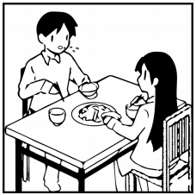
四、看图写话。
1. impolite, talk, when
It’s impolite of the boy/him to talk when (he is) eating.

Slide 12
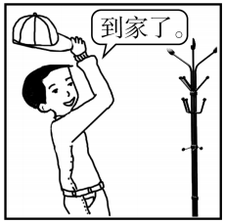
四、看图写话。
2. take off, after
The boy/He took off his cap after he arrived/got home.

Slide 13
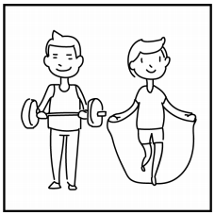
四、看图写话。
3. exercise, now
They are exercising/doing exercise now.

Slide 14

四、看图写话。
4. necessary, keep
It’s necessary to keep quiet in the library./
It’s necessary that people keep quiet in the library.

Slide 15
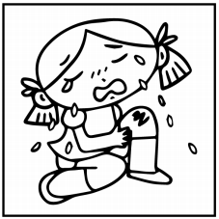
四、看图写话。
5. hurt, yesterday
The girl/She hurt her left knee yesterday.

Slide 16


